Slide 1
MongodB
MongoDB is a source-available, cross-platform, document-oriented database program. Classified as a NoSQL database product, MongoDB utilizes JSON-like documents with optional schemas. MongoDB is developed by MongoDB Inc. And current versions are licensed under the Server Side Public License (SSPL). MongoDB is a member of the MACH Alliance.

Slide 2
Abstract
MongoDB is a document-oriented and open-source NoSQL database, which is one of the most well-known NoSQL databases. In compared to traditional relational databases, MongoDB applies binary format of the JSON-like documents and dynamic schemas.
MongoDB is a document store for JSON objects and was introduced.Since the replication architecture of MongoDB is similar to that of HBase, the MongoDB architecture is described only briefly here. The comments and techniques for keeping data consistent covered under the previous HBase section also apply to MongoDB.
The replication architecture of MongoDB is illustrated.Multiple MongoDB nodes can be configured as a replica set, in which the data stored in MongoDB will be replicated. As in HBase, each individual node is actually a collection of MongoDB servers, among which the MongoDB table is sharded. MongoDB requires that the replica set contain an odd number of members (a null server called the arbiter can be added if it is desired to use two or some even number of actual replicas).

Slide 3
Content
Introduction
Sub topics
Diagrams
Conclusion
Reference

Slide 4
Introduction
MongoDB is built on a scale-out architecture that has become popular with developers of all kinds for developing scalable applications with evolving data schemas. As a document database, MongoDB makes it easy for developers to store structured or unstructured data. It uses a JSON-like format to store documents.
MongoDB is used for high-volume data storage, helping organizations store large amounts of data while still performing rapidly. Organizations also use MongoDB for its ad-hoc queries, indexing, load balancing, aggregation, server-side JavaScript execution and other features.

Slide 5
Sub topics
Replication
A replica set is two or more MongoDB instances used to provide high availability. Replica sets are made of primary and secondary servers. The primary MongoDB server performs all the read and write operations, while the secondary replica keeps a copy of the data. If a primary replica fails, the secondary replica is then used. Scalability.
MongoDB supports vertical and horizontal scaling. Vertical scaling works by adding more power to an existing machine, while horizontal scaling works by adding more machines to a user’s resources. Load balancing.
MongoDB handles load balancing without the need for a separate, dedicated load balancer, through either vertical or horizontal scaling.

Slide 6
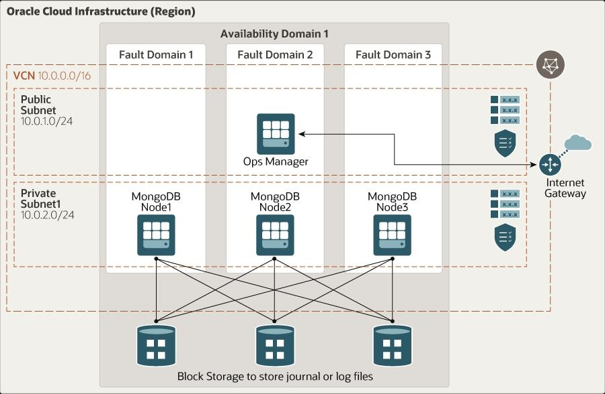
Diagrams

Slide 7
Conclusion
MongoDB is a powerful NoSQL database solution that offers flexibility, scalability, and performance for modern applications. Its document-oriented model allows for easy handling of unstructured and semi-structured data, making it ideal for projects where data schemas evolve rapidly.
In conclusion, MongoDB provides developers with a robust platform for building and managing applications that require dynamic and agile data storage. Its rich feature set, including sharding, replication, and flexible querying, makes it a popular choice for businesses across various industries seeking to leverage the advantages of NoSQL databases. However, like any technology, MongoDB should be carefully evaluated against specific project requirements to ensure it aligns with the needs and goals of the application.

Slide 8
Reference
As seen in the MongoDB relationships, to implement a normalized database structure in MongoDB, we use the concept of Referenced Relationships also referred to as Manual References in which we manually store the referenced document’s id inside other document. However, in cases where a document contains references from different collections, we can use MongoDB DBRefs As an example scenario, where we would use DBRefs instead of manual references, consider a database where we are storing different types of addresses (home, office, mailing, etc.) in different collections (address_home, address_office, address_mailing, etc). Now, when a user collection’s document references an address, it also needs to specify which collection to look into based on the address type. In such scenarios where a document references documents from many collections, we should use DBRefs.

Slide 9


